Slide 1
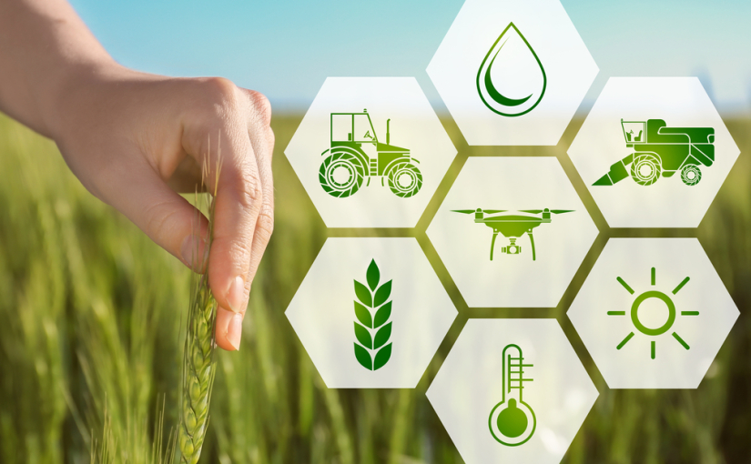
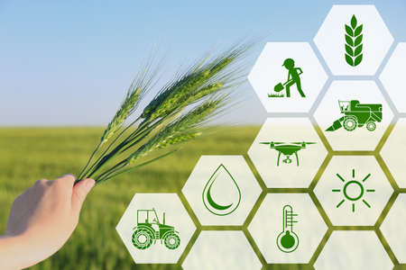
IDEA Presentation
Smart agriculture
LEELAVATHI M
2021UCT1055

Slide 2
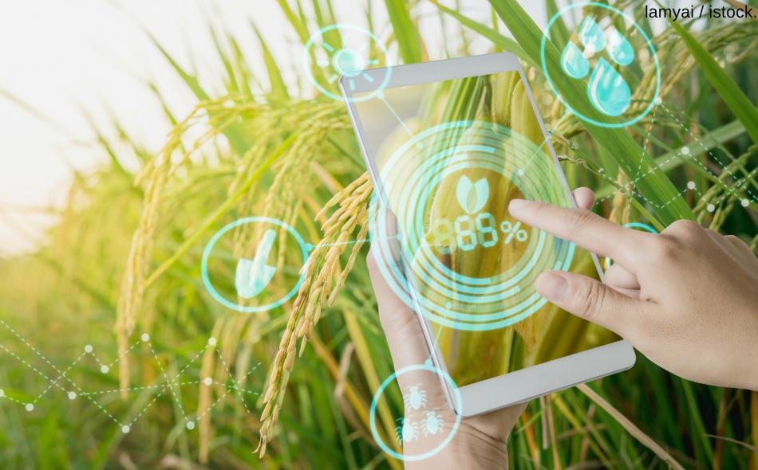
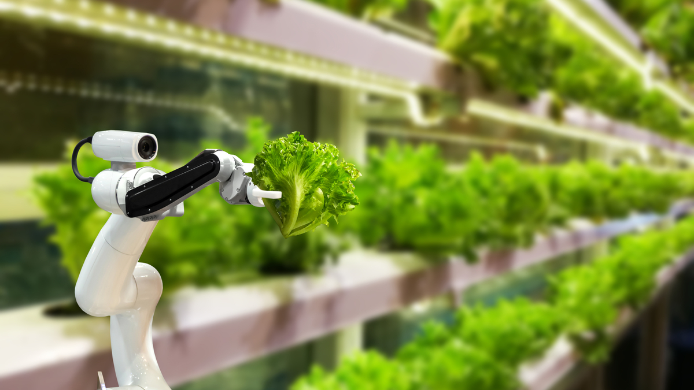
what's smart agriculture
Smart farming is a management concept focused on providing the agricultural industry with the infrastructure to leverage advanced technology – including big data, the cloud and the internet of things (IoT) – for tracking, monitoring, automating and analyzing operations.

Slide 3
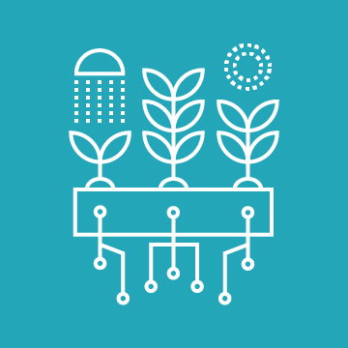
Problem statement of smart agriculture
The traditional agriculture and allied sector cannot meet the requirements of modern agriculture which requires high-yield, high quality and efficient output. Thus, it is very important to turn towards modernization of existing methods and using the information technology and data over a certain period to predict the best possible productivity and crop suitable on the very particular land. The adoptions of access to high-speed internet, mobile devices, and reliable, low-cost satellites (for imagery and positioning) are few key technologies characterizing the precistre agriculture trend
IoT has been making deep inroads into sectors such as manufacturing, health-care and automotive. When it comes to food production, transport and storage, it offers a breadth of options that can improve India’s per capita food availability. Sensors that offer information on soil nutrient status, pest infestation, moisture conditions etc. which can be used to improve crop yields over time.

Slide 4
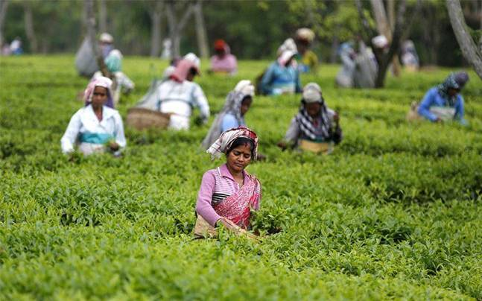
1. Tea Industry
a) Use of pesticides / fertilisers more than required quantity leads to rejection of the produced Tea.
b) Plucking coarse leaves will lead to drop in the quality of made Tea.
c) Tea pruning is widely used to keep the plants in ideal shape. However, too much pruning leads to destruction of the plant.
d) Processing of Tea from the leaves (withering, curled, fermentation, dried, sieves and packed) is a hectic and robust job.
e) Maintaining ideal storage condition.
f) Exported / supplied stocks are rejected by the customers due to undesired quality.

Slide 5
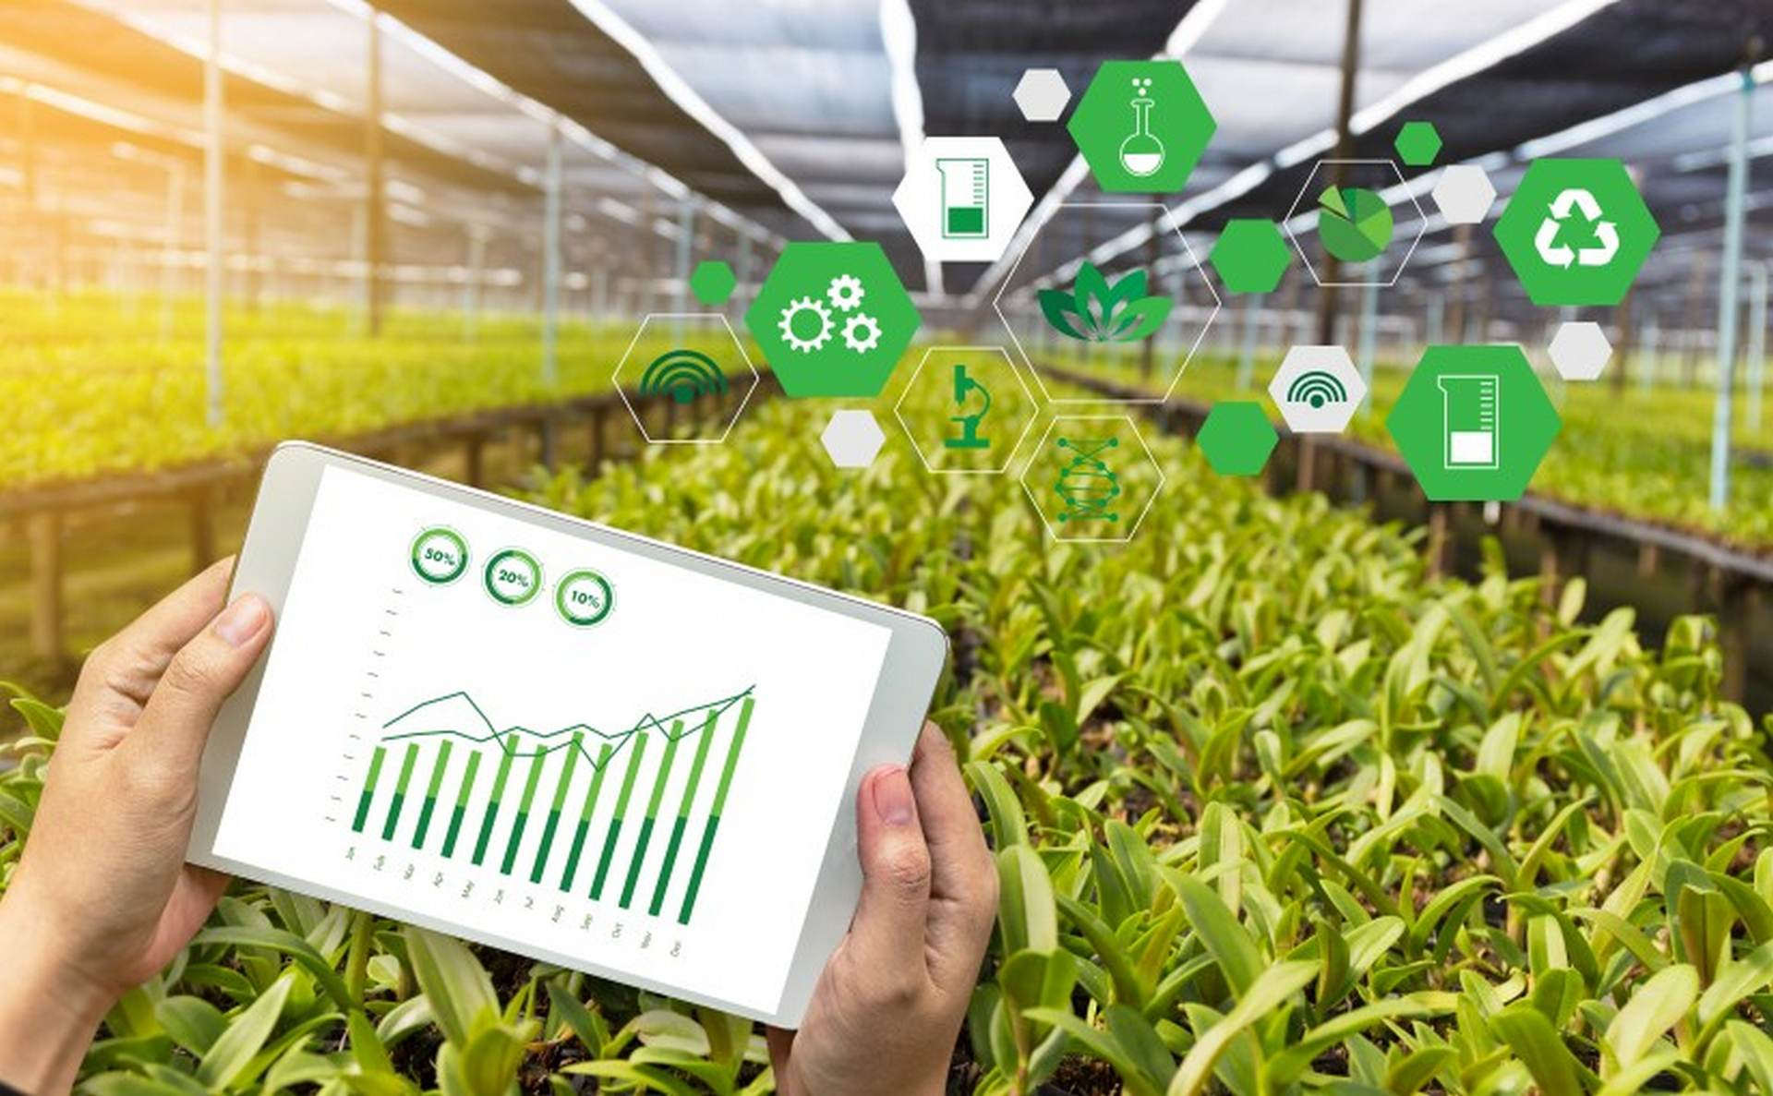
2. IoT enabled micro irrigation and farming land health logging system
History-based soil health parameters like soil moisture, pHlevel, temperature etc. are very essential of organic cultivation. IoT applications may assist in controlling the irrigation pump, opening and closing water flowing gates and also data logging the soil health conditions for present and future purpose. Further, with the help of IoT applications, provision for live guidance based on stored date of soil health from professional/experts to farmers in remote locations may be made available.

Slide 6
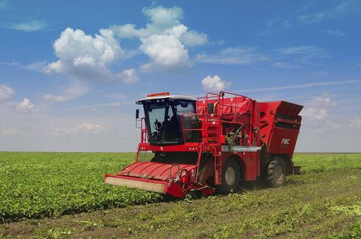
3. Eco-Harvester for fruits
The Eco-harvester injects an artificial PME enzyme activator which allows the detachment of only the mature fruits from the branches of the tree leaving behind the immature ones and thereby allowing them to mature, thus minimising harvesting loss. IoT application may be used to keep track when and which part of the field is ready for the process.

Slide 7
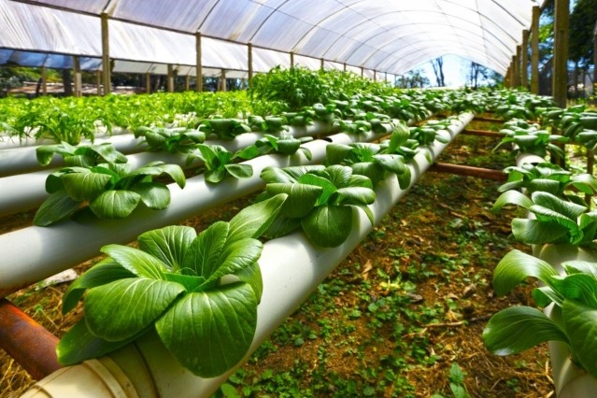
4. Smart Greenhouses
Greenhouse farming is a methodology that helps in enhancing the yield of vegetables, fruits, crops etc. Greenhouses control the environmental parameters through manual intervention or a proportional control mechanism. IoT applications can immensely benefit the farmers using greenhouse technology and make their work simple & easy.

Slide 8
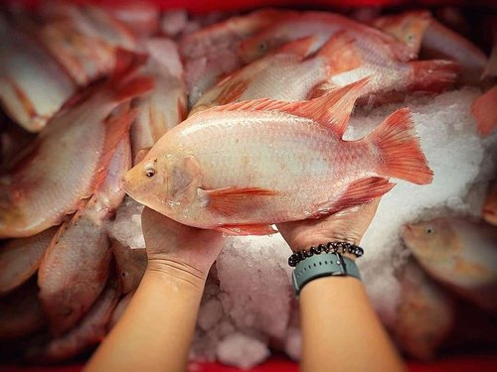
5. Fish-farming and breeding
The consumption of fish in Assam is very high. But the fish-farming and breeding techniques haven’t improved much to meet the growing demand of fish in the region. To increase the productivity and reduce input cost, IoT application to monitor dissolved oxygen, pH indicator, Ammonium nitrate indicator as well as automatic fish feed system can help reduce manpower and improve quality & quantity.

Slide 9
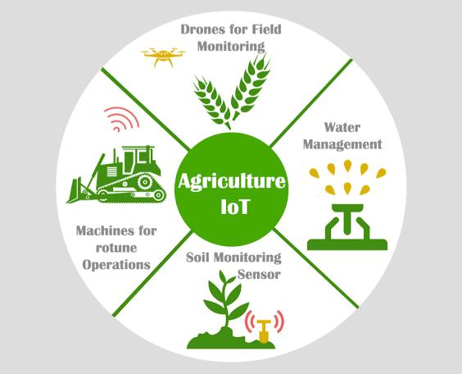
How loT technology is benefiting today's modern farming industry

Slide 10
Abstract
Use of technology in different areas to get numerous benefits is itself a valuable research. Use ofSensor network in the area of agriculture is not new. But due to the different weather, soil, water and landconditions, diverse models, methods of analysis and solutions are needed on which different communities ofresearchers are working and proposing several solutions. That instigates need of some different waysspecifically for agriculture that can be helpful in developing solution for different conditions.Ubiquitous Computing and Context-Aware Computing are highlighting the approaches to deal with variabilityin conditions, situations and problems. The combination of different technologies and their applicationtowards certain area is always been a challenging task. The combination of emerging technologies includingubiquitous computing, context-aware computing and grid computing with sensor network can be applied onagriculture domain to make the agriculture smarter.In this chapter, the concept of Smart Agriculture is described and use of different advanced technologiestowards the agriculture domain is highlighted. The evolution of agriculture through the support of differentadvanced technologies is also presented. Some details about the development of smart agriculture prototypefor irrigation control are also the part of this chapter.

Slide 11
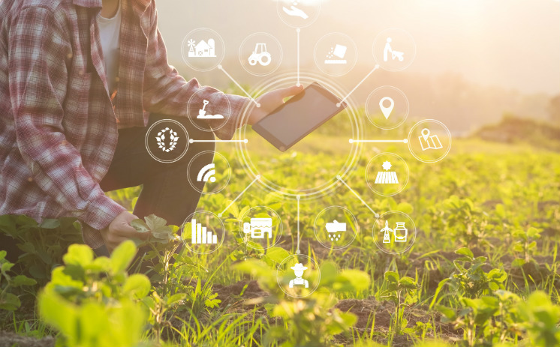
Management Information System - MIS/Control Centers
COMPONENTS
A Farm Management Information System (FMIS) is a system developed for collecting, processing, storing and disseminating data that benefit and control the functions of the farm. These form the nucleus of the smart farm system and help the farmers make the best decisions regarding planting, fertilizing and harvesting crops by collecting and processing data in real time. The type of Management information systems used in smart agriculture systems is possible thanks to advances in Microcontrollers by companies such as Sonix, STM Microelectronics, and Microchip.

Slide 12
CONCLUSION
In this chapter, the authors presented the concept of smart agriculture.
Increase in population and demand for food requires some new methods that could increase the production multiple times utilizing the even lesser resources as shortage of water is increasing day by day and agriculture land is also decreasing.
Use of advanced technologies could help us in this regard.
The concept of smart agriculture presented could be helpful in achieving the above mentioned goal.
Smart agriculture concept is the utilization of different advanced technologies together with the experiences of people as well as the results of the historic events to engender better solution of the problems.
The technologies that were highlighted in this chapter are sensor network technology, satellite navigation technology, grid computing technology, ubiquitous computing technology, context aware computing technology and the cloud computing technology.

Slide 13
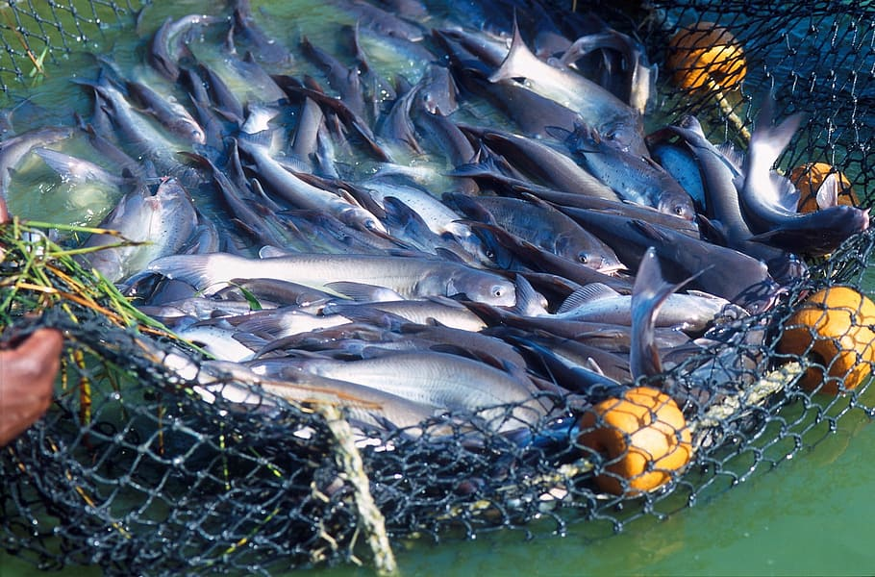
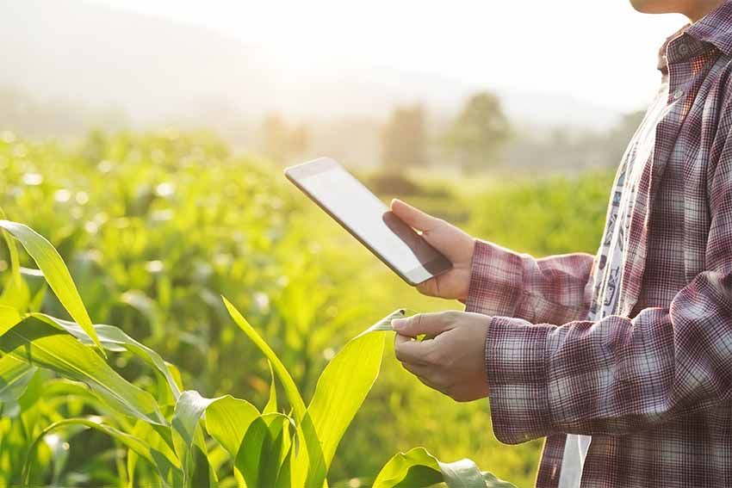
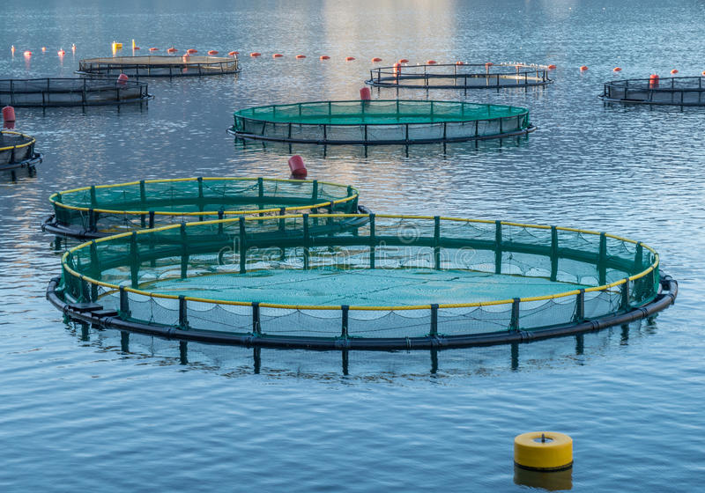
THANK YOU
THANK YOU

